Slide 1
Class –Object Concepts
Presented By
M.Pallavi

Slide 2
Class-Definition
A class is a template definition of the method s and variable s in a particular kind of object. Thus, an object is a specific instance of a class; it contains real values instead of variables.
A class can have subclasses that can inherit all or some of the characteristics of the class. In relation to each subclass, the class becomes the super class.
Subclasses can also define their own methods and variables that are not part of their super class.
The structure of a class and its subclasses is called the class hierarchy.

Slide 3
object
An entity that has state and behavior is known as an object e.g., chair, bike, marker, pen, table, car, etc.
It can be physical or logical (tangible and intangible).
The example of an intangible object is the banking system.

Slide 4
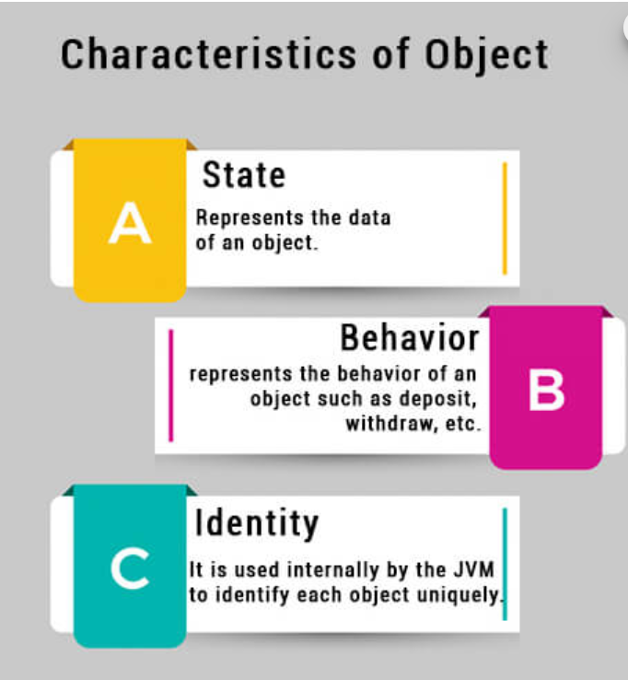
An object has three characteristics:

Slide 5


Slide 6
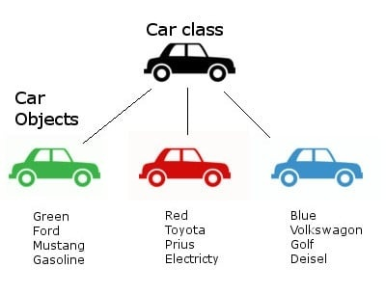
Class object example :

